Slide 1
Predicting Gentrification Using Data
Project 1
Michael padilla, dennis o’leary, & rosarys esquilin

Slide 2





What is gentrification?

Slide 3

Gentrification is the process of repairing and rebuilding homes and businesses in a deteriorating area (i.e. an urban neighborhood) accompanied by an influx of middle-class or affluent people, resulting in the displacement of earlier, usually poorer residents.
>>> Merriam-Webster, Incorporated

Slide 4

Predicting Gentrification… Using Data.

Slide 5
“I know it when I see it.” >>>Tanvi Misra - Staff Writer, City Lab
Signs of gentrification:
Increase in rent & home/ property value
Change in the district’s character & culture
Increase Income
Increase in BA/MA Degrees
Starbucks??
Race

Slide 6
Tell-Tale Signs:
Increase in Home / Rent Value
Increase in Income
Increase in Bachelor’s Degrees

Slide 7

Diving Into the Data
This Photo by Unknown Author is licensed under CC BY

Slide 8


Data Used:
This Photo by Unknown Author is licensed under CC BY-SA
This Photo by Unknown Author is licensed under CC BY-SA

Slide 9

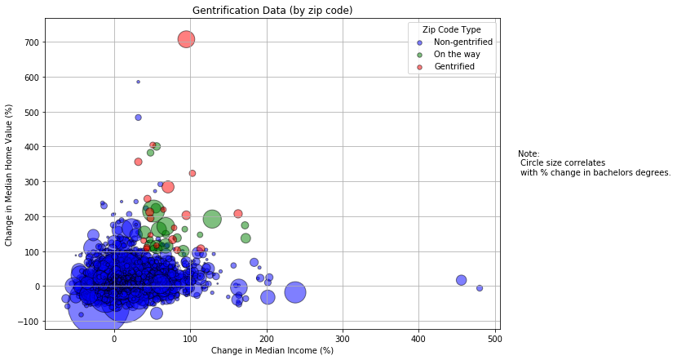
2000 – 2016
Built for base, non-gentrified, and 'predictive' zip codes
Circle size correlates with % change of bachelors degrees.

Slide 10
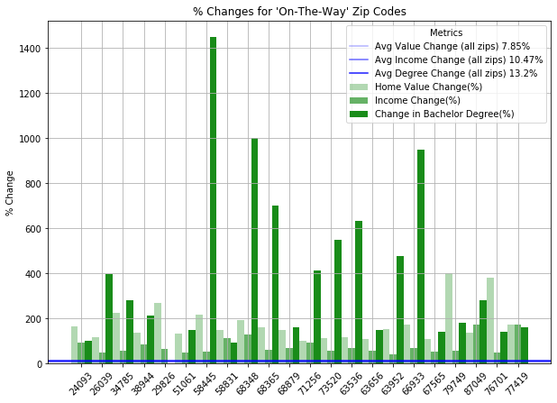
2000 – 2016
Built for areas that are “on-their-way” to gentrification (by top 20 zip code)
Displays average changes (by all zip codes)
Grace City, ND | Elk Creek, NE | Barnes, KS | Grafton, NE | Downing, MO

Slide 11
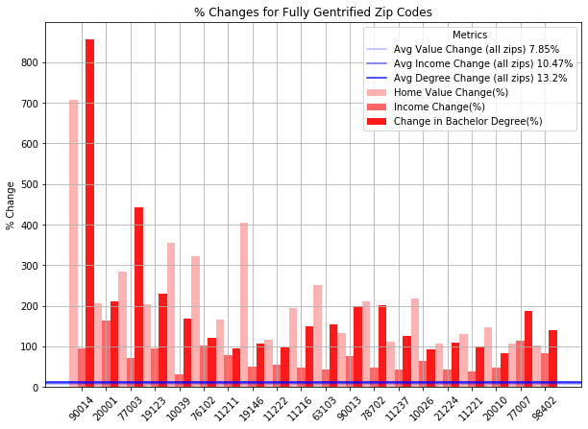
2000 – 2016
Built for areas that are fully gentrified (by top 20 zip codes)
Displays average changes (by all zip codes)
Downtown LA, CA| Houston, TX | Philadelphia. PA | Washington, DC | Austin, TX

Slide 12
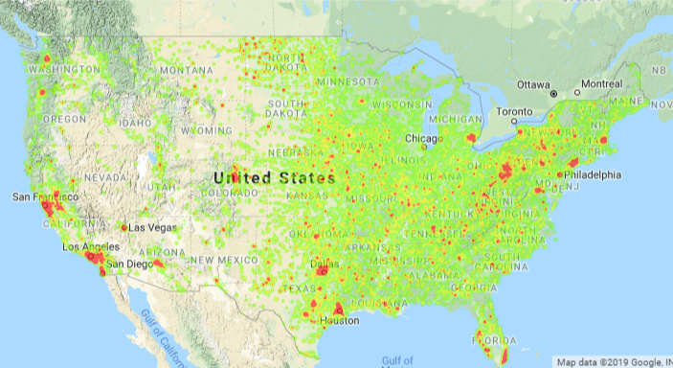
Home Value

Slide 13
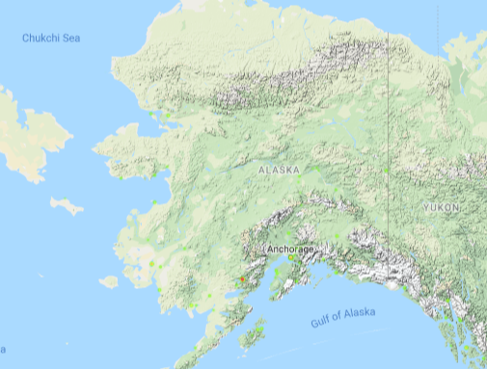
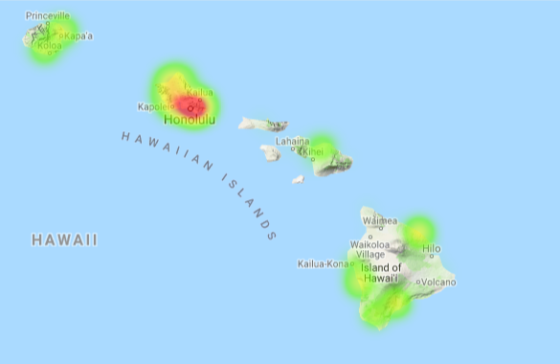
Home Value

Slide 14
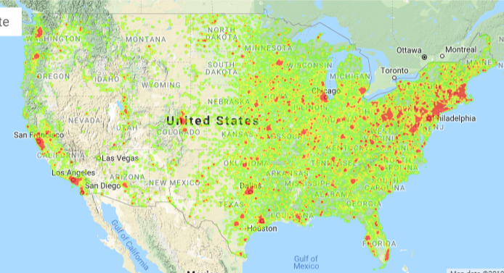
Rent

Slide 15
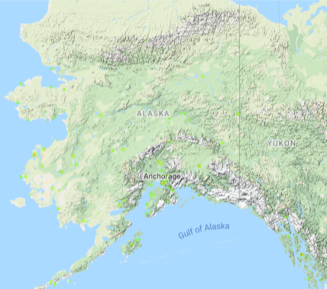
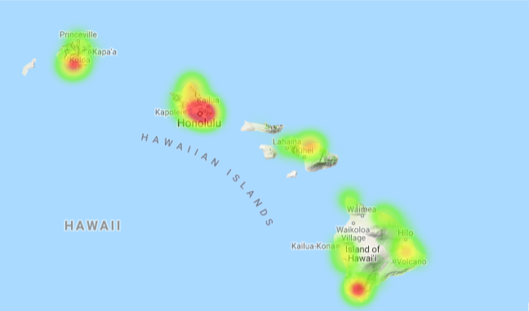
Rent

Slide 16
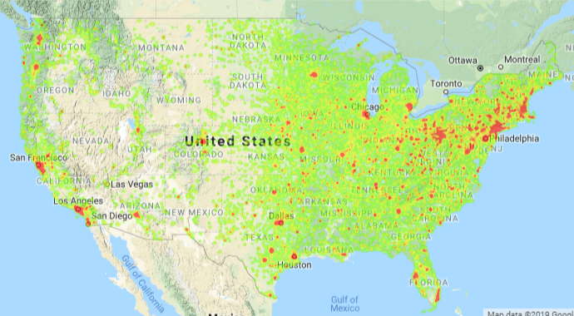
Income

Slide 17
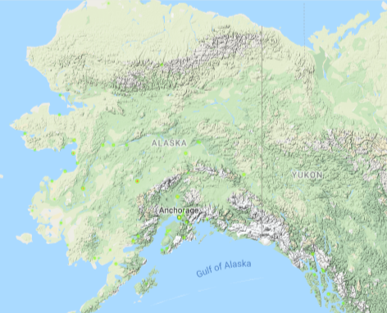
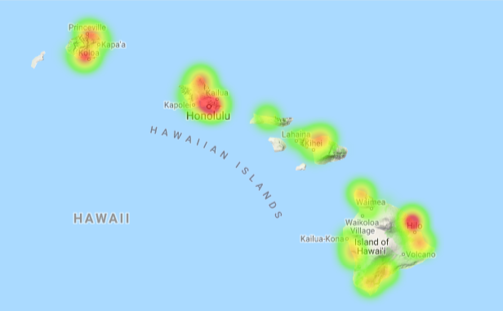
Income

Slide 18
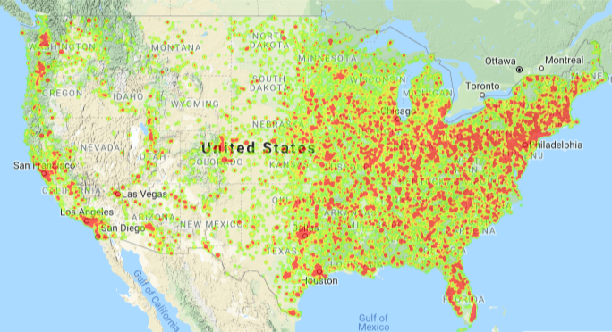
Degree

Slide 19
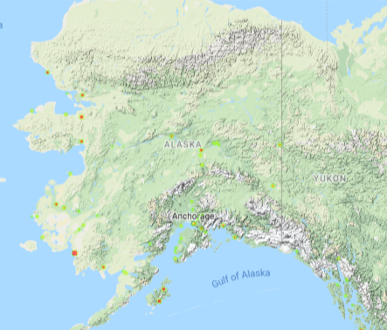
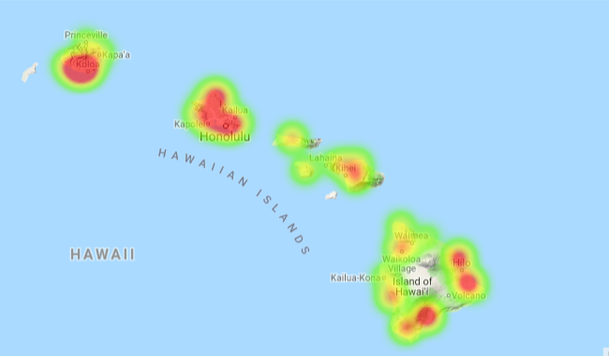
Degree

Slide 20
Takeaways…
Urban/ Suburban areas are at higher risk of gentrification
The Midwest continues to experience a slow change in income & home value due to being run under a rural economy
Signs of gentrification are more evident on the coasts.

Slide 21


Slide 22

Thank you!

